Slide 1
Current Telecommunication Landscape
U.K and France
20021046 Bae, Yong-gook
20021076 Lee, Jin-sung
20021079 Lee, Tae-ju
20021090 Cho, Kyoung-ho
20031005 Ko, Dae-won

Slide 2
France

Slide 3
History and Regulation (1850-1945)
1889
Nationalized SGT’s network
1878
Postal&Telegraph Ministry
1890-1915
# of telephones in France more than doubled every five years
15,432 to 357,515
1944
CNET created
the Centre National d'Etudes des Télécommunications
1880
the Societé Générale du Telephones (SGT)
1850
1945
1883
The first telephone exchange in Rheims
1851
Monopolic Telegraphic Services
1924
Standard model of price and service
1887
The first international circuits
Paris - Brussels
1913
The first automated exchange in Nice

Slide 4
History and Regulation (1945-1995)
Mid 1960s
Digital switching experiments
1987
CEC Green Paper
(Commission of the European Communities)
1970
Fiber optic cable
to support signal transmission
1945
1995
1947
The first coaxial links
Paris - Toulouse
1990
The French legal act passed on July 2, 1990, on the organization of public posts and telecommunications services, transformed France Télécom (formerly Direction Générale des Télécommunications) into a public service carrier with corporate legal status.

Slide 5
Regulator(1/2). ART
The law of 26 July 1996
Opened the telecommunications sector to full competition
Scheduled for 1st January 1998
ART
Autorité de Régulation des Télécommunications
Established on 5th January 1997 by the law of 26th July 1996
Operated on the basis of the law of 1996
The law of 20 May 2005
Parliament adopts the law on the regulation of postal activities
The law assigns the regulation of these activities to ART
ART becomes ARCEP

Slide 6
Regulator(2/2). ARCEP
ARCEP
Autoritè de Règulation des Communications Electroniques et des Postes
The legislature made ARCEP responsible for overseeing the liberalization and proper functioning of the postal market as well as its financing and the protection of universal postal service.
ARCEP fulfils this mission by:
issuing authorisations for activities being opened to competition
accounting and price controls for universal service
settling disputes among operators
monitoring La Poste’s universal service mission and its performance in terms of quality of service
making recommendations and issuing opinions on the financing of universal service

Slide 7
Major Regulations
26 July 1996
The telecommunications regulation law is adopted
13 May 2004
Parliament adopts the law for trust in the digital economy (LEN) which gives municipalities the right to become telecommunications operators
1995
2005
April 2002
The European Commission publishes the “telecoms packet” directives
5 January 1997
ART is created
3 June 2004
Parliament adopts the law transposing the new European regulatory framework into French law
20 May 2005
Parliament adopts the law on the regulation of postal activities which assigns the regulation of these activities to ART.
ART becomes ARCEP.

Slide 8
Some other milestones
Dec. 1999 – Feb. 2000 / High-speed access
ART orders France Telecom to submit its ADSL access offers for approval
1st January 1998
The voice market is liberalized
(long distance and international)
25 July 2002 / WiFi
The 2.4 GHz frequency band is liberalized
1995
2005
23 July 2003
Mobile number portability is implemented
31 December 2003 / Universal service The US law is approved
2 April 2004 / Mobile
Orange France and SFR’s GSM licences are renewed for 15 years

Slide 9
France Telecom
History
1878 : creation of the Postal and Telegraph ministry.
1970 : the 6th Plan highlights the role of telecommunications in the French economic development.
1974 : The general direction of the postal and telecommunications services becomes the biggest public investor and one year later, the telephone "catching up" Plan is adopted.
1988 : creation of France Telecom.
1991 : France Telecom becomes an autonomous provider of a public service.
1996 : France Telecom becomes a public limited company.
1997 : France Telecom opens its capital and its shares are traded on the stock markets in Paris and New York.
2000 : France Telecom launches its Internet subsidiary, Wanadoo, on the Paris stock market and also acquires the British mobile telephone operator Orange and becomes the 2nd largest European player in the mobile industry.

Slide 10
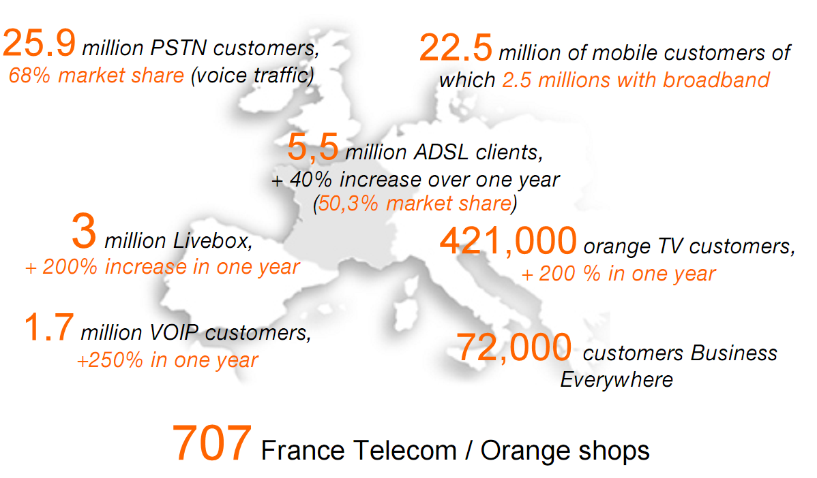
France Telecom
Overview
The third largest telecom operator in Europe in terms of revenue behind Deutsche Telekom and Vodafone
The dominant key player in France
Fixed-line
Broadband
Mobile
Notes:
1. France Telecom

Slide 11
The advance of FT into foreign countries
Active foreign business investment
France government, FT and Alcatel together
Mobile service and Value Added service in EU
Infrastructure development in developing countries
Financing when government enterprise switch to private capital in EU
Strategic alliance with Deutsche Telecom
Global alliance with Sprint

Slide 12
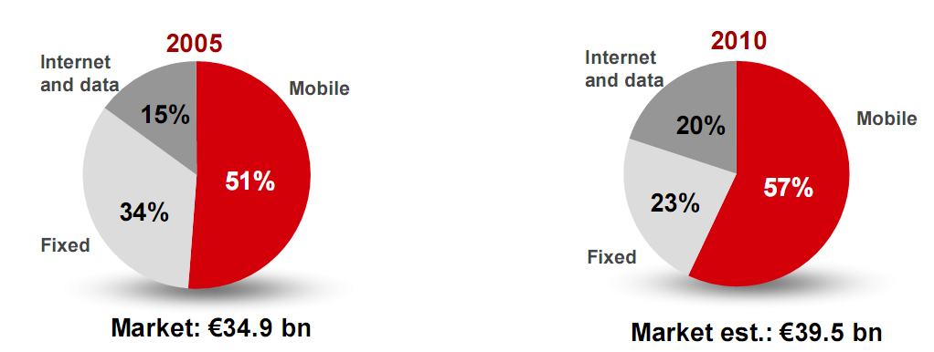
France Telecom
Status
In the fixed telephony sector, its primary industry, France telecom is facing increasing competition.
Moreover, the size of fixed-line market have continued to decline reflecting the fixed/mobile substitution trend
Notes:
1. IDATE

Slide 13
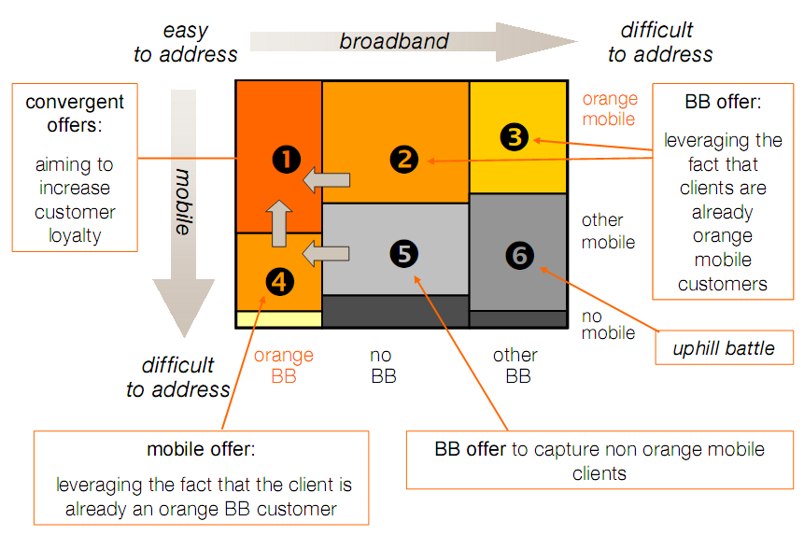
France Telecom
Strategy - Convergence
Be the first provider of new convergent offers and devices
Background
multi-equipment expected to increase all over Europe
number of households likely to opt out their existing contract for mobile & broadband bundle (in million)
Bundles, a starting
point for simplicity and
convergent services
Leading position supports
the development of new
usages and convergent
offers
Notes:
1. France Telecom

Slide 14
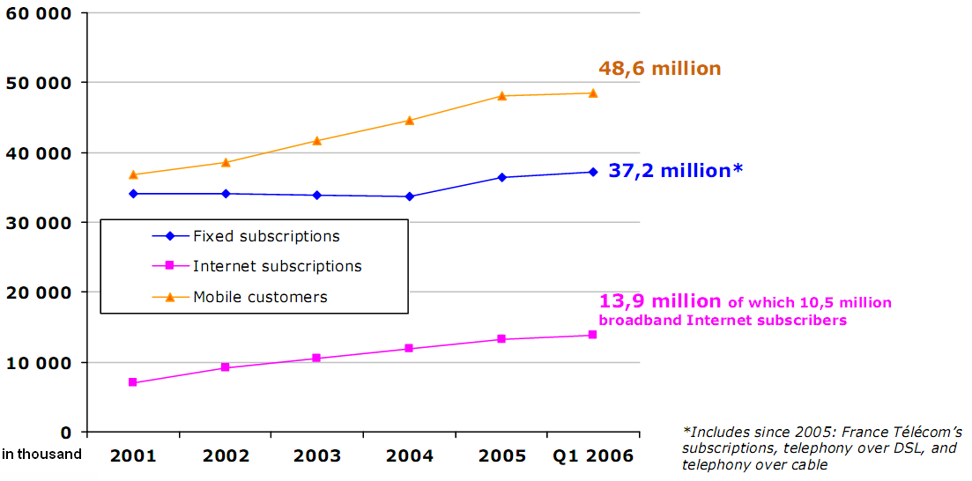
The French Market
The increase in fixed telephony subscription having been unable to compensate for the decline in calling revenue
The growth rates of the internet and mobile services are slowed in revenue
Notes:
ARCEP
ARCEP, EC Observatory - Annual surveys from 1998 to 2005; quarterly survey for 2006 (estimated figures).

Slide 15
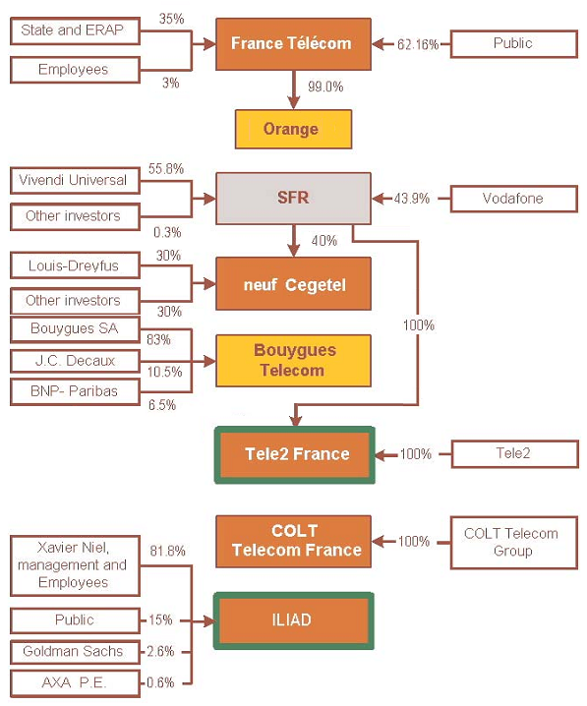
Major Telecommunications Operators
Company Service | France Telecom | CGE | Bouygues | MFS
Local | Yes | CATV infra | PCD based | -
Long Distance | Yes | IRIS(AT&T partner) | Yes | Dedicated line
GSM | Yes | SFR (Societe Francasi de adiotelephone) | Yes | -
Multimedia, Broadcasting | online-service | - | - | -
Notes:
1. IDATE (modified by J.S.)

Slide 16
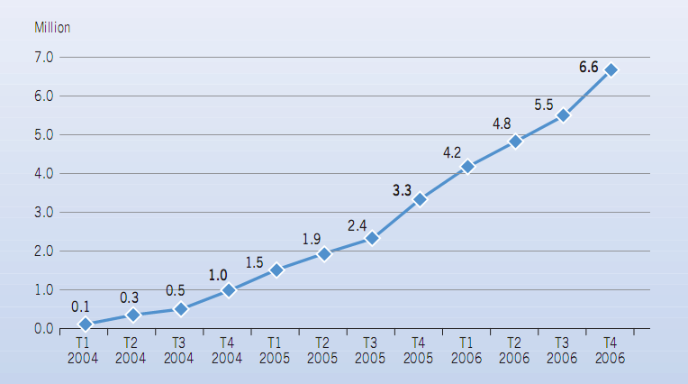
Fixed-Line Market
Major Operators
France Telecom : 33.7M customers
Neuf Cegetel : 3.1M customers
Iliad : 1.6M customers
Achived 100% electrical automation in 1994
Public telephone bill system : IC card
This leads best IC card technology in the world
VoIP situation
The number of fixed telephony subscriptions increased by 1.7 million in 2006, due to a sharp rise in the number of VoIP subscriptions (+3.2 million)
France ranks 3rd in terms of VoIP subscribers around the world
Notes:
1. ARCEP

Slide 17
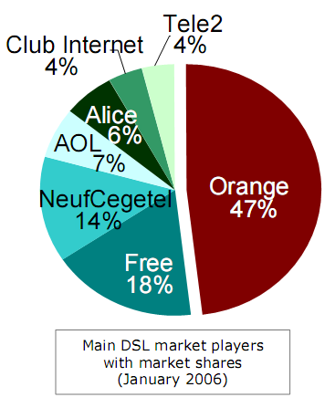
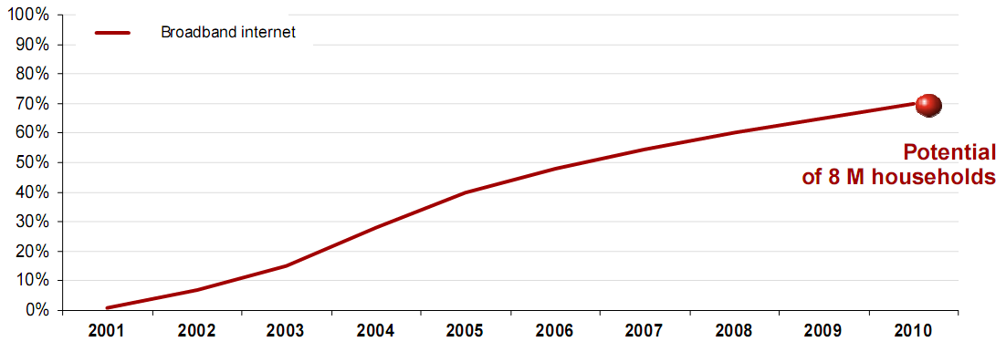
The French Broadband Market
Major Operators
Orange : 4.5M connections
Free (Iliad) : 1.6M connections
Neuf Cegetel : 1.2M connections
The number of broadband subscriptions
reached 12.7 million at the end of 2006
xDSL subscribers are more than 90% of the total broadband market
The retail broadband market is not regulated in France,
but the CATV market is strongly regulated.
Notes:
ARCEP
ARCEP, EC Observatory - Annual surveys from 1998 to 2005; quarterly survey for 2006 (estimated figures).

Slide 18
Mobile Market in France
Major Operators
Orange : 22.4M subscriptions (Start at 1992 with GSM900)
SFR : 17.2M subscriptions (Start at 1992 with GSM900)
Bouygues : 7.5M subscriptions (Start at 1996 with GSM900)
The mobile subscriber base has been growing at an annual rate of between 7% and 8% since 2003.
In 2006, it increased by 7.5%
Notes:
1. ARCEP, EC Observatory - Annual surveys from 1998 to 2005; quarterly survey for 2006 (estimated figures)

Slide 19
Number of Clients and Market share
 | 1998 | 1999 | 2000 | 2001 | 2002 | 2003 | 2004
Orange | 5,539 (49.7%) | 10,051 (48.7%) | 14,311 (48.2%) | 17,823 (48.2%) | 19,216 (49.8%) | 20,329 (48.8%) | 20,371 (48.6%)
SFR | 4,201 (37.7%) | 7,335 (35.6%) | 10,160 (34.2%) | 12,555 (33.5%) | 13,547 (35.1%) | 14,724 (35.3%) | 14,800 (35.3%)
Bouygues | 1,400 (12.6%) | 3,233 (15.7%) | 5,211 (17.6%) | 6,619 (17.9%) | 5,823 (15.1%) | 6,630 (15.9%) | 6,670 (16.1%)
Total | 11,104 | 20,619 | 29,682 | 36,997 | 38,586 | 41,683 | 41,941
Most active player : CGE
- SFR,TDR are daughter companies of CGE
- CGE is national warterworks
- CGE also launched CATV market in compliance with RWE(GER)

Slide 20
Mobile Market in France
Open competition market
Most competitive market
Smaller market than UK and Germany in size
French mobile market has still strong growth potential
82% of mobile penetration at end December 2006
12 million potential new customers
Notes:
1. ARCEP

Slide 21
Issue –Convergence of broadcasting and communication Law
Background
ART & CSA had first meeting in 2002
They prepare for fusing communication and broadcasting
MCC(Ministere de la Culture et de la Communication) establish law for eletrical and visual communication service
NEW LAW : ‘Electrical communication law’
Substitutes ‘communication’ and ‘broadcast’ into ‘eletrical and visual communication’
Relaxation of entry and network
Abolish the regulations
Now : It is on ratifying process

Slide 22
New regulator in the new law
 | Communication Law | Broadcasting Law | Electrical Communication Law
Ministry in charge | MEFI | MCC | MCC
Market regulation | ART | ART | CSA
Contents regulation | - | CSA | CSA

Slide 23
Progress of the Law Establishment
Date | Process | Subject
’02.7.31 ~’02.9.20 | Public research for ‘law for electrical and visual communication’ | MCC
’03.3.21 | Opinion submission of both councils | ART,CSA
’03.4.1 | Pre-document for law | Secretary of MCC
’03.4.29 | ART opinion submission | ART
’03.5.14 | Second pre-document for law | MCC
’03.5.27 | CSA opinion submission | CSA
‘04.2.4 | Alfred Trassy-Paillogues report | The lower house
’04.2.4 | Emmanuel Hamelin opinion | Standing committee of the-lower house
’04.2.11 ~’04.2.12 | Examination of the lower house | The lower house
04.4.15~ | Examination of the upper house | The upper house
<Source: KISDI, Taesun Park, 2004.4>

Slide 24
United Kingdom

Slide 25
History and Regulation (1850-1960)
1892
Naionalization in long distance telephone service
1880
Widen PO’s area
to telephone service
1850
1960
1869
Post Office
1912
Foundation the monopoly system in all service by government
1888
Private telephone company made

Slide 26
History and Regulation (1960-1995)
1969
Making General Post office
1984
-British telecom(BT) was founed
1985
BT and Mercury started
their cellular service
1986
Mercury started
Long distance service
1982
Vodafone was founded
1960
1995
1991
Permit the complete competition about local service
Start the CATV service without Oftel’ permition
Fixed telecom service by mobile companies
Readjustment of service fee on BT
Selling the stock of BT(48%)

Slide 27
Major Regulations
December 2003
Office communications(Ofcom)
was founded
1984
-Office telecommunications(Oftel) was made
DTI(Department of Trade and Industry) was founed
July 2003
- Communications Acts
1980
2005
1991
Publish the ‘Competition and Selection’ : Starting the complete competition
1981
Communications Acts
: separate communications and post service
6 September 2004
Establish ‘New voice Service’ to permit VOIP service

Slide 28
Some other milestones
1988
- TAT8(Optical service through the Atlantic
1986
Starting CSS(Customer Service System) first time in the world
Starting the digital international telecommunication service btween London and tohyo
1996
-Starting the super-high way service
‘Cellstream’ in UK
1980
2005
1989
Satellite telephone system
‘Skyphone’ started
Noveber 2001
- Vodafone portal site ‘Live!’

Slide 29
Regulator. Ofcom
Before Ofcom, there are many regulatory institutions
Office of Telecommunications(Oftel)
The Radiocommunications Agency
The Radio Authiority
The Broadcasting Standards Commission
The Independent Television Commission
Communications act (July 17th of 2003)
Encourage the capital from other blocks(not only Europe)
Deregulation about useless policies on broadcasting and radio market.
Office of communications(Ofcom, December of 2003)
➔ to do such things as they consider appropriate for facilitating the implementation of,
or for securing the modification of, any relevant proposals about the regulation of communications.
Aboveboard process about regulation
Achieve efficiency through competitive

Slide 30
Organization chart of Ofcom

Slide 31
Actual actions of Ofcom
CPS(Carrier Pre Selection : Helping the destitute operator to establish their networks in BT’s local exchange)
+
LLU(Local Loop Unbundling : Keeping away BT from using their power for lend bundled share local loop)
Indirect access
Number Portability
Wholesale Line rental
➔ To restrain the exclusive power of
BT in the market

Slide 32
British Telecom
Divided
LLU
Number portability
Start Oligopoly with Mercury
1869
1984
1992
2001
2003
Re-entered wireless
Established
Competition Start

Slide 33
Vodafone
Start Service
3G
1982
1985
1991
2001
Earned wireless license
GSM Start

Slide 34
Overview of Fixed Line Telecommunication
Matured
2 Major Players
LLU
Number Portability (2001)
Carrier-Pre Selection (2001)

Slide 35
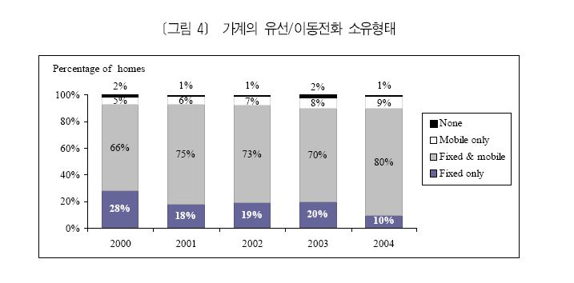
U.K Fixed Telephone Market

Slide 36
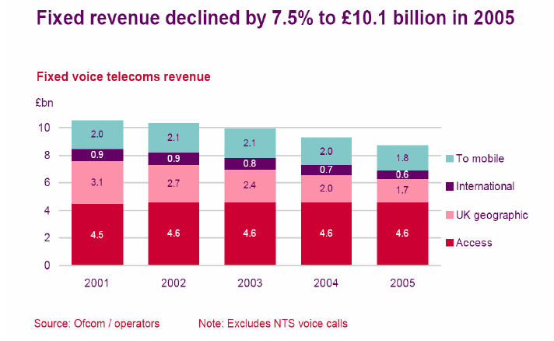
U.K Fixed Telephone Market
Although about 90% of home has fix telephone, the revenue from fix voice telecoms is get smaller and smaller!

Slide 37
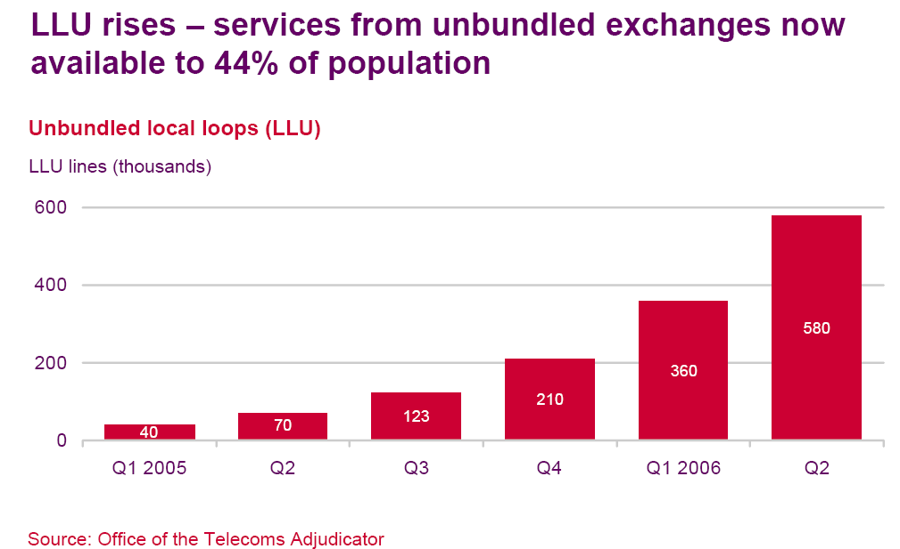
Rise of LLU

Slide 38
Overview of U.K Mobile Market
Matured Market
Over 60 Million Handset
5 Major Players in Market
Vodafone GSM 900 Mhz
O2 GSM 900 Mhz
Orange GSM 1800 Mhz
T-Mobile GSM 1800 Mhz
Three 3G/UMTS
2G Generation is mostly used
3G Service is not matured
MVNO → Virgin and Tesco

Slide 39
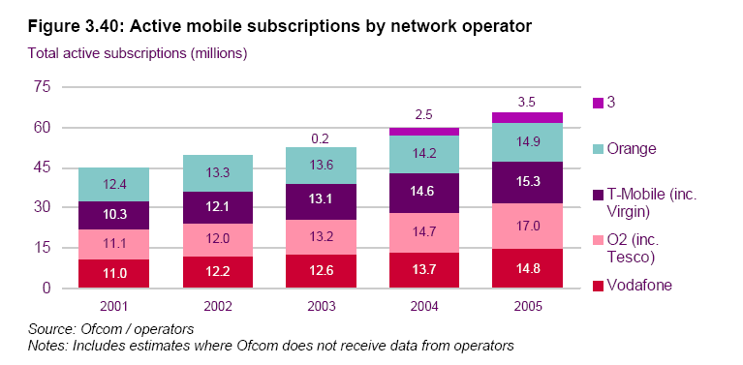
U.K Mobile Telephone Market Share

Slide 40
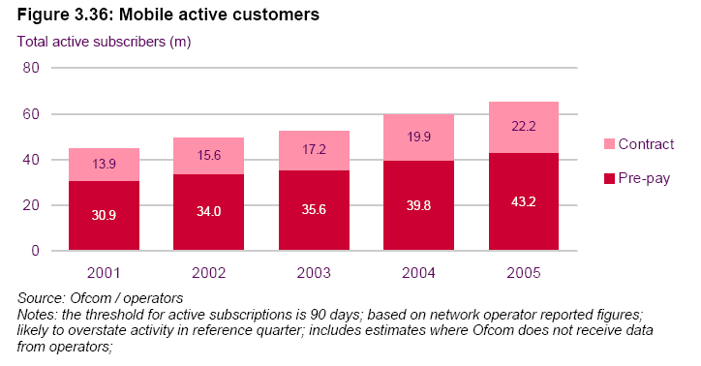
U.K Mobile Customer Types

Slide 41
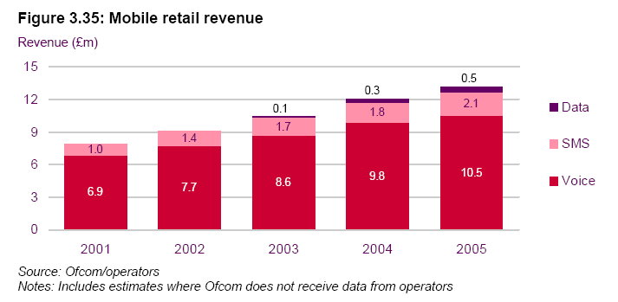
U.K Mobile Retail Revenue

Slide 42
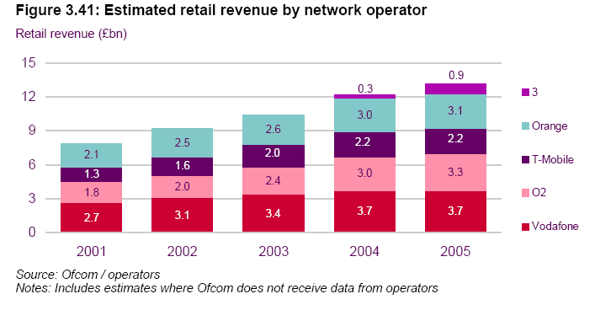
U.K Mobile Retail Revenue by Operator

Slide 43
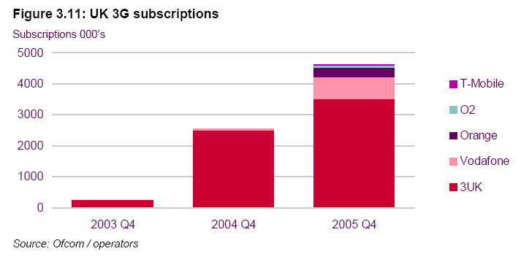
U.K 3G Customer Market Share

Slide 44
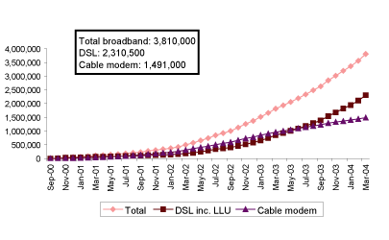
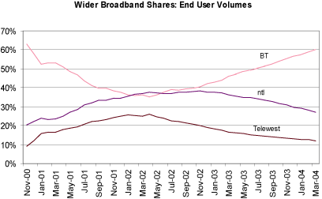
Overview of Broadband Market

Slide 45
Recent Trend
Competition
Price
Ofcom tries to limit the dominant power of BT by many regulations. LLU, number portability and 3G market are the good example of this regulations and it looks well worked. However, BT tries to expand market power by bundling service.

Slide 46
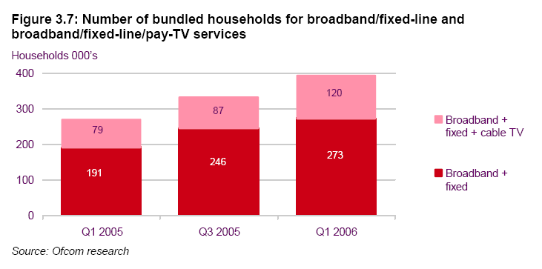
Bundling Service

Slide 47
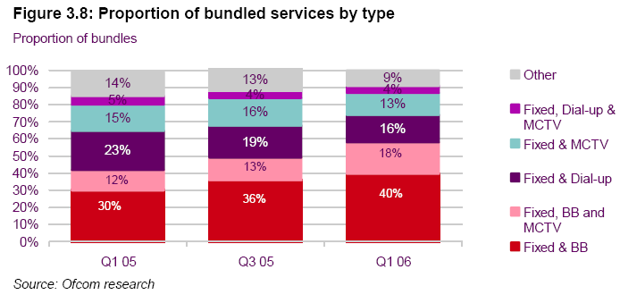
Bundling Service

Slide 48
Reference
김병은. 2002. “프랑스와 독일의 통신시장 현황과 통신법 개정의 주요 내용”. KISDI
김원식 외. 2004. “유럽주요국의 통신방송융합 대응사례 분석”. KISDI
박종현. 2005. “통신-방송 융합 대응과 규제체계 분석 연구”. KISCOM
박태순. 2004. “유럽연합의 전자커뮤니케이션 산업 정책의 실체”
임동민. 2004. “정보통신정책 356호”. KISDI
Answers.Com. 2007. “France Telecom Group”. http://www.answers.com/topic/france-telecom-group?cat=biz-fin
ARCEP. 2005. “EC Observatory – Annual surveys from 1998 to 2005”
ARCEP. 2006. “Electronic Communications Regulation in France”. Global Forum.
ARCEP. 2007. “Introducing ARCEP - The French Telecommunications and Posts Regulator”.
France Telecom. 2006. “France Transformation”.
Ofcom. 2006. “The International Communications Market 2006”
SFR. 2006. “Introduction to SFR”
Ofcom. 2006 “영국시장 개요”
Ofcom. 2006 “The Telecommunication Market 2006”
Vodafone.de

Slide 49
Reference
BT.com
Ofcom.org.uk
한국 KISDI. 1995 “영국정보통신자유와 과정”
한국 KISDI. 2004 “영국 통신시장의 전개 현황”
한국 KISDI. 2005 “영국 소비자의 통신 서비스 이용 현황”
한국 KISDI. 2006 “영국 Ofcom. 통신부분 정책의 성과 평가 계획 발표”
한국 KISDI. 2006 “영국 VoIP의 규제 현황”

